Slide 1

Question 10 Chanae Smith, Victor Ziegler, Dario Bassi

Slide 2
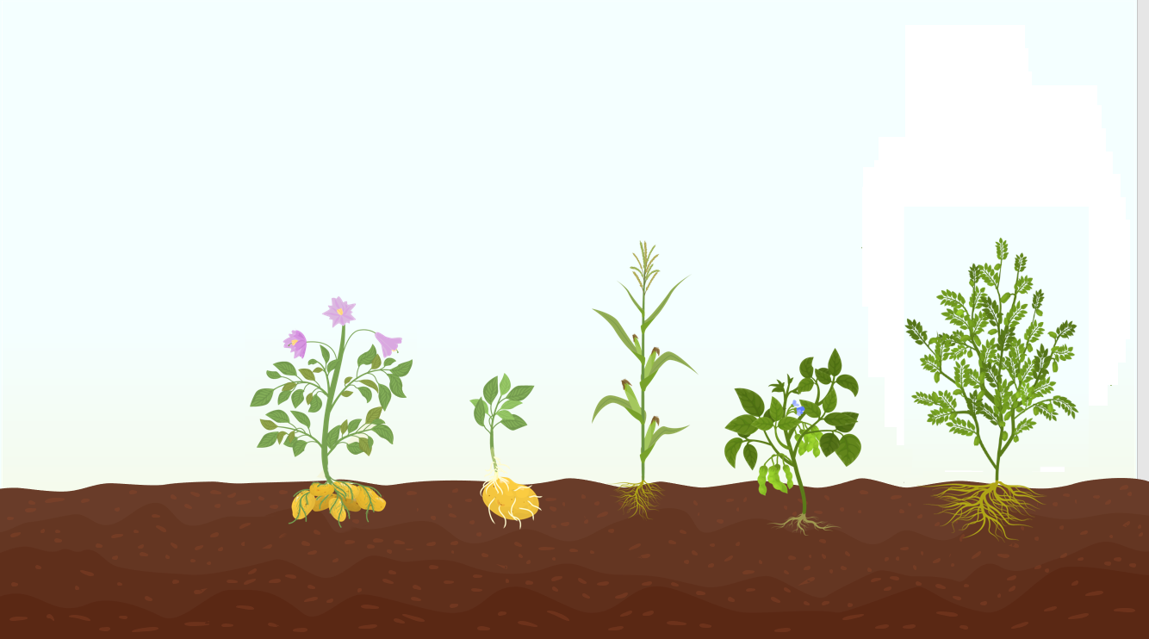
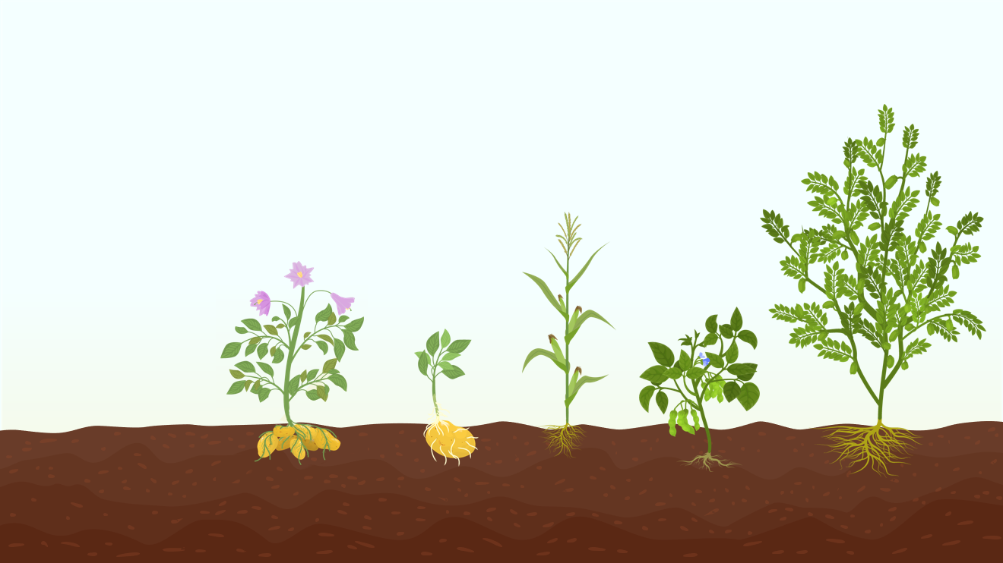

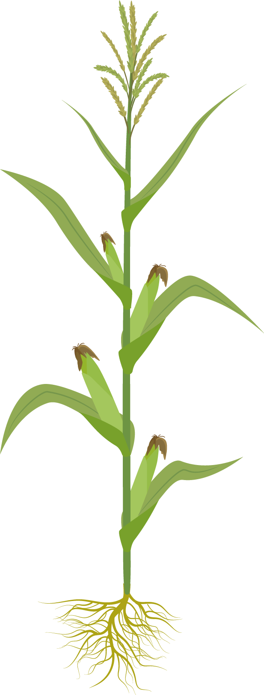


The Experiment:
Goodbye
Researchers measured the yield of 5 crop species treated with 4 fertilizers. You find the measurements in the file fertilizer.dat on ILIAS.
We hope you have understood the importance we have on planet Earth. Without us, it would be difficult for you to live
Take care of us and we will take care of you!

Slide 3
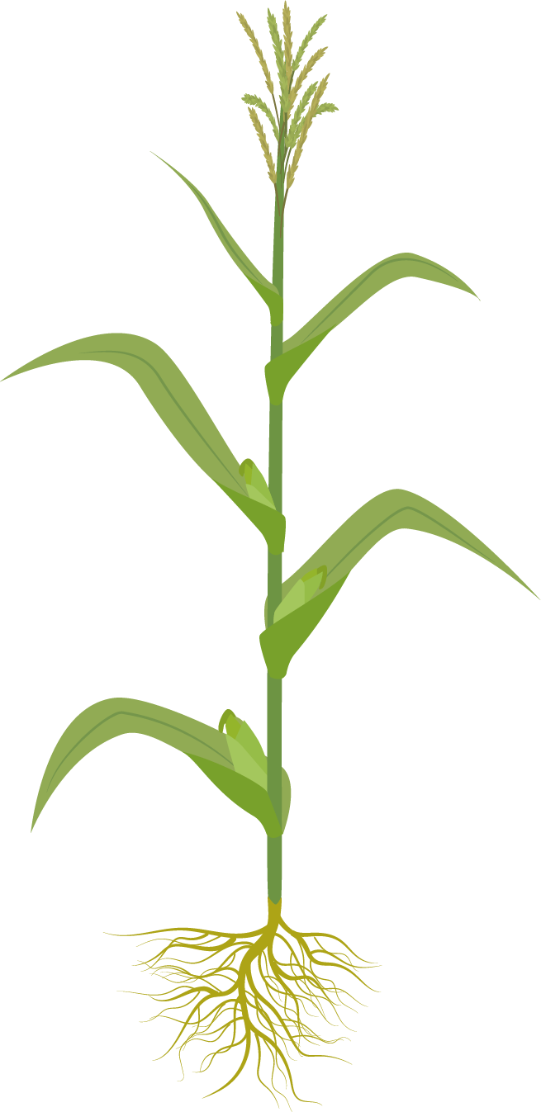



Table of contents
01
05
The Data
ANOVA with Interaction
02
06
Interaction Plot
Model Selection
03
07
ANOVA without Interaction
Discussion
04
Data Transformation

Slide 4

01
The Data
What does our data look like?

Slide 5
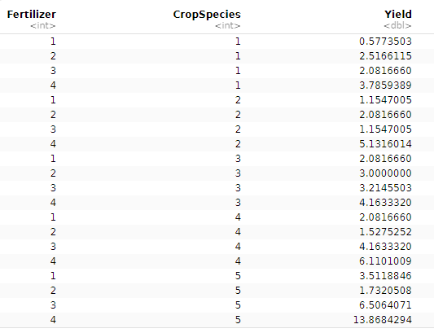
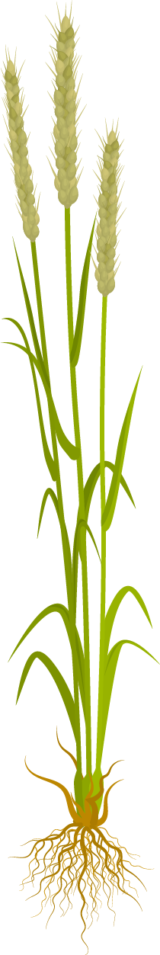

Excerpt of Data

Slide 6
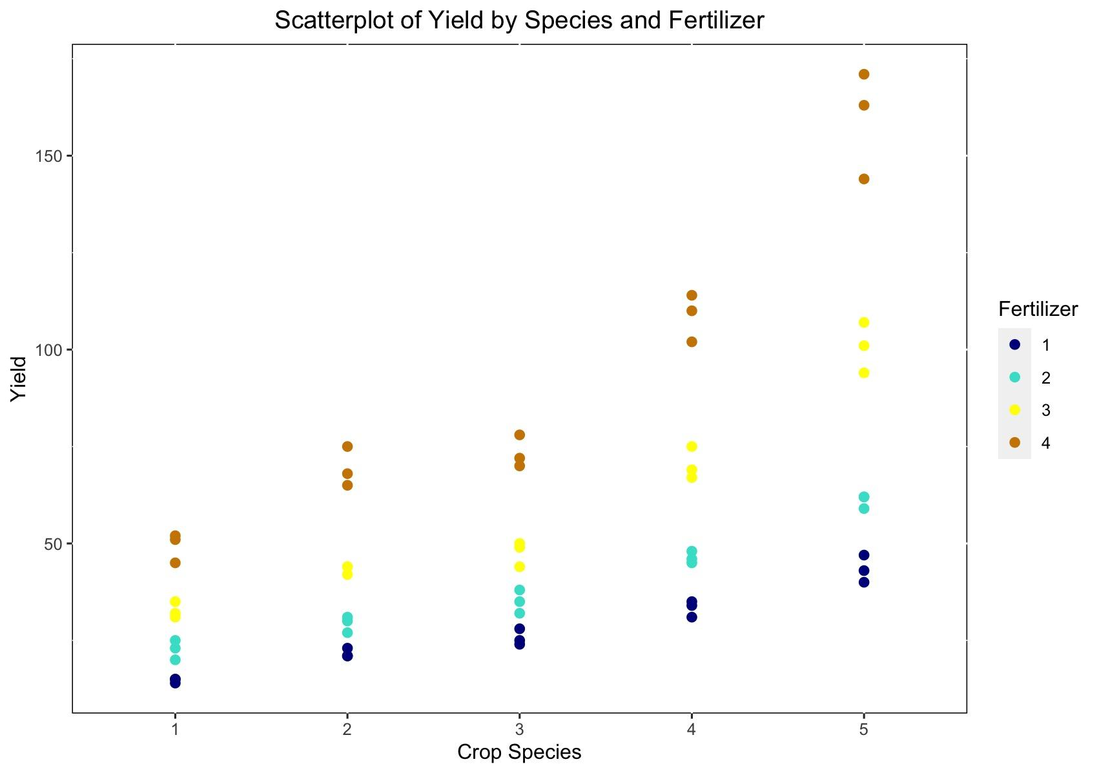
A
Notes:
- This plot shows the relationship between crop species and yield, with the yield varying across different types of fertilizers.
- There's a noticeable trend where certain species, particularly species 5, appear to respond better to fertilizers 3 and 4 with higher yields.

Slide 7
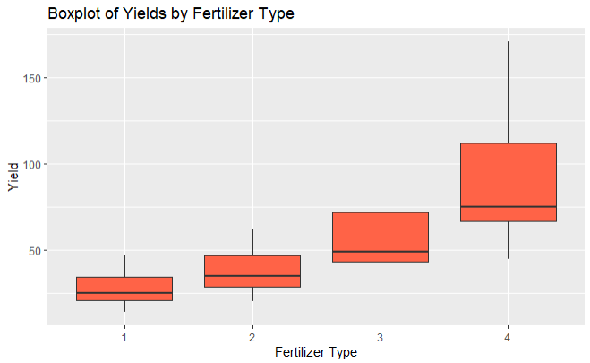
Notes:
- The box plot gives a summary of the distribution of the data, including the median (the central line), the interquartile range (IQR, the box's length), and outliers.
- Different fertilizers have varying effects on yields, with fertilizer type 4 showing the widest range and highest median yield, indicating it might be the most effective or variable in its effectiveness.
- The median yield for fertilizer types 1 and 2 is lower and the boxes are more compact, suggesting a tighter distribution around the median with less variability.
- Fertilizer 3 has a slightly higher median, but its interquartile range (IQR) is only a little larger than types 1 and 2, indicating a similar spread of data around the median.
- Type 4 has the highest median and a much larger IQR, indicating more variability in yield.

Slide 8
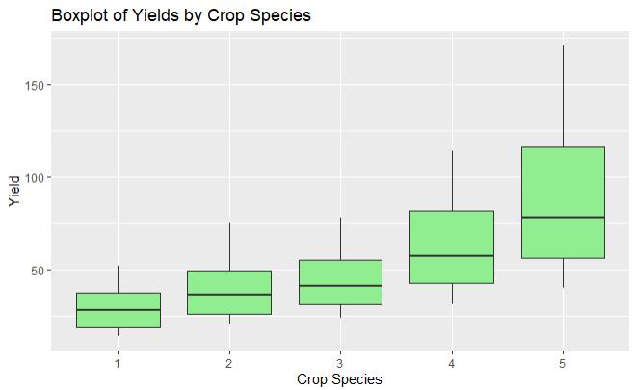
Notes:
- Crop species show different median yields and variability.
- Species 1, 2, and 3 have similar median yields and IQRs, suggesting a consistent yield distribution around the median.
- Species 4 has a slightly higher median yield but also has a wider IQR, suggesting more variability.
- Species 5 has the highest median yield and a very large IQR, showing that the yields for this species are the most variable among the five species.

Slide 9
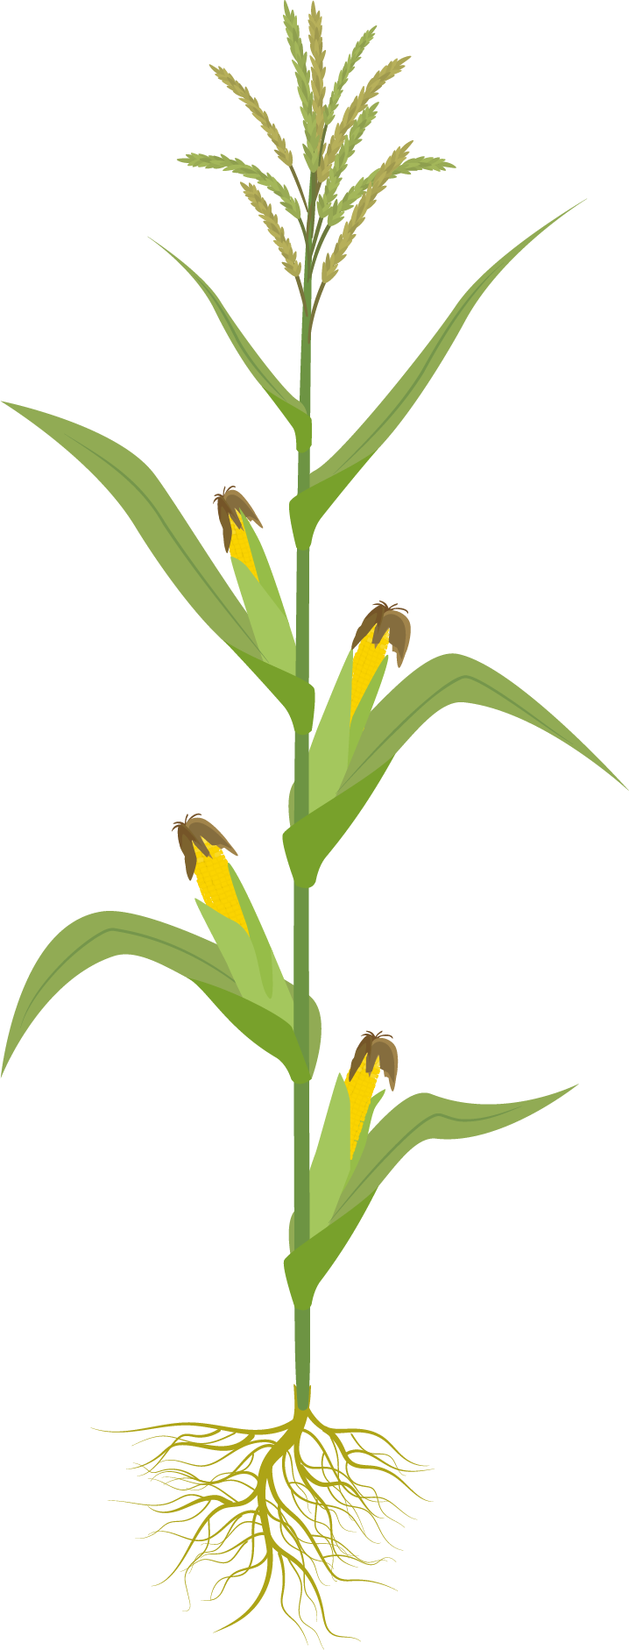
02
Interaction Plot
(a) Read in the data set and draw an interaction plot.

Slide 10
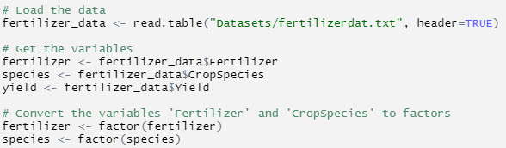
Before creating the interaction plot, the variables Fertilizer and CropSpecies must be converted to factors.

Slide 11
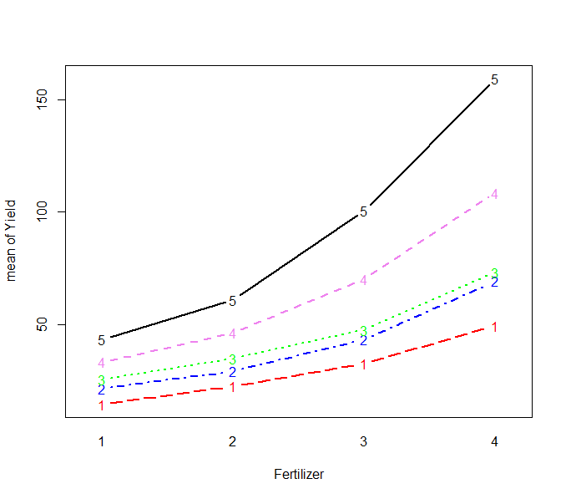
The interaction plot shows how the mean yield changes for 5 crop species across 4 levels of fertilizer.
The lines in each section are not all parallel - the effect of the fertilizer on yield is not consistent across different crop species.
Conclusion: unclear - there may be a subtle interaction between fertilizer type & crop species - the effect of one factor may depend on the level of the other factor.
Notes:
Two-way anova without interaction assumes that the factors do not interact to affect the outcome variable. In other words, the effect of one factor is consistent at all levels of the other factor.

Slide 12
ANOVA without Interaction
(b) Fit an ANOVA model without interaction. Analyse the residuals. Does the model fit well?
03

Slide 13
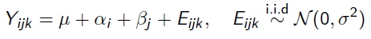
Two-Way Ordinal ANOVA without Interaction
Evaluates whether there are any significant differences between the means of three or more unrelated groups when there are two independent variables (factors).
Formula
Assumptions
No heterogeneity of variance
Y = i + f + s + E, where
i -> intercept:
f -> effect of fertilizer type
s -> effect of species of crop
Normally distributed
Samples are independent
Notes:
Assumptions:
The populations have equal variances (homogeneity of variance).
The populations from which the samples are drawn are normally distributed.
The samples are independent.

Slide 14
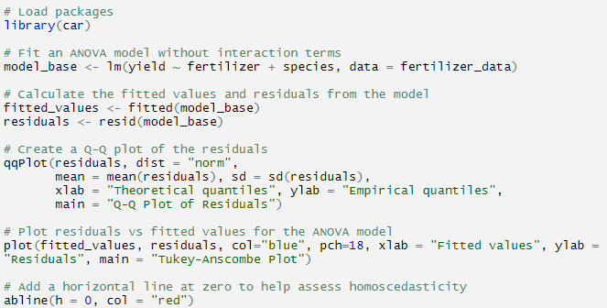

Slide 15
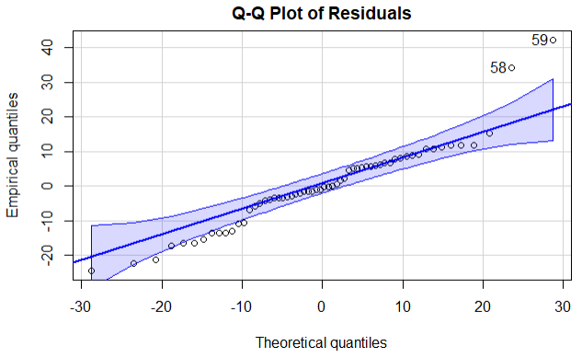
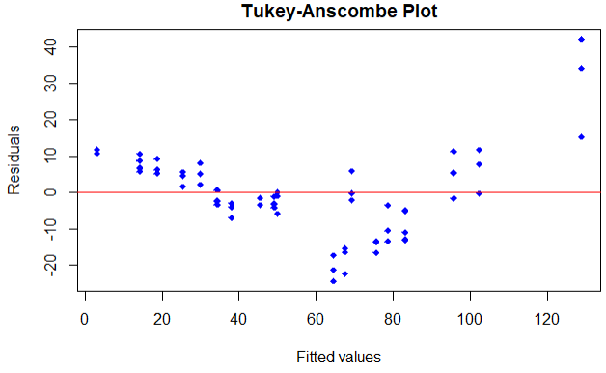
Residual Analysis
Residuals are not normally distributed, and are right-skewed.
Residuals fan out as fitted values increase. They show heteroscedasticity.
Conclusion: Two-way ANOVA Model without interaction does not fit well.

Slide 16
04
Data Transformation
(b) If the model does not fit well, which transformation could make the fit better?

Slide 17
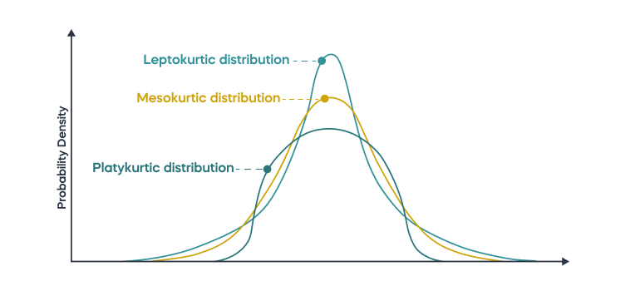
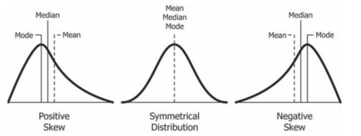
Describing the distribution

Slide 18
Which Transformation to Use?
Box-Cox transformation
Skew | Moderate | High | Higher | Extreme
Positive (right tail) | Square root | Natural log | Log base 10 | Inverse
Negative (left tail) | Reflect then square root | Reflect then natural log | Reflect then log base 10 | Reflect then inverse
Source

Slide 19
Which Transformation to Use?
The skewness coefficient gives a numerical measure of the skewness of the data distribution.
Skew | Moderate | High | Higher | Extreme
Positive | Square root | Natural log | Log base 10 | Inverse
 | >= 0.5 and <= 1 |  | >1
Negative | Reflect then square root | Reflect then natural log | Reflect then log base 10 | Reflect then inverse
 | >= -1 and <= -0.5 |  | < -1
Source

Slide 20
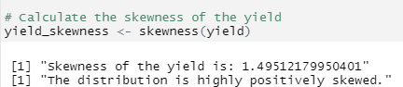
Which Transformation to Use?
Try log transformation
Compare to square root transformation

Slide 21
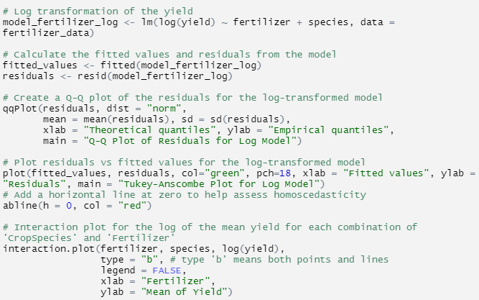
Log Transformation

Slide 22
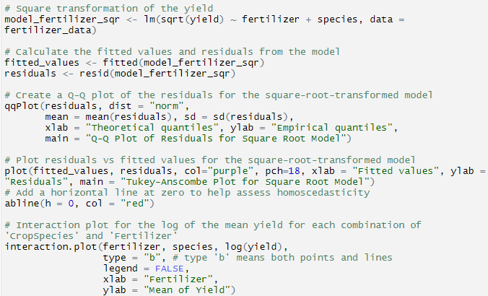
Square Root Transformation

Slide 23
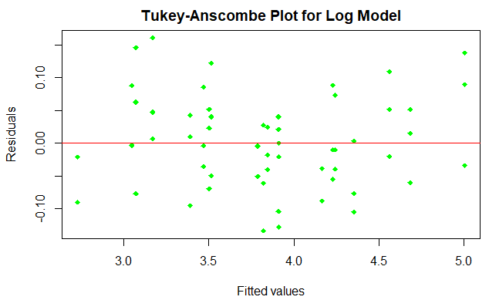
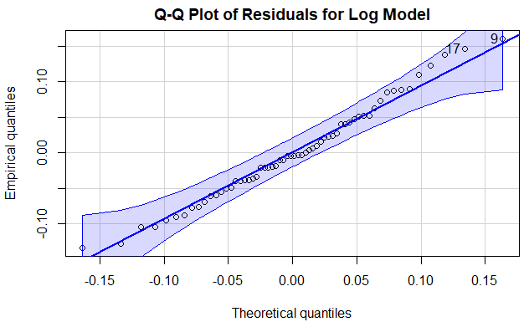
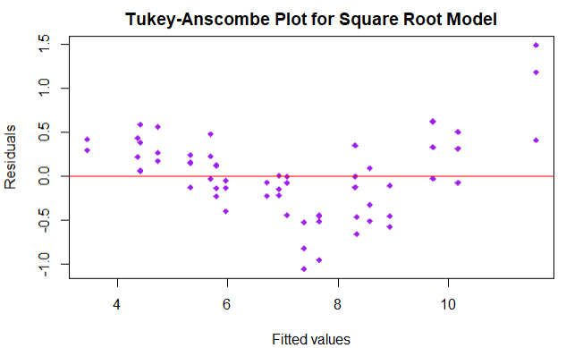
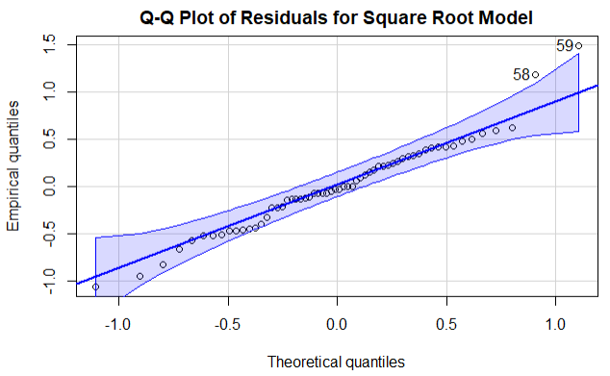

Slide 24
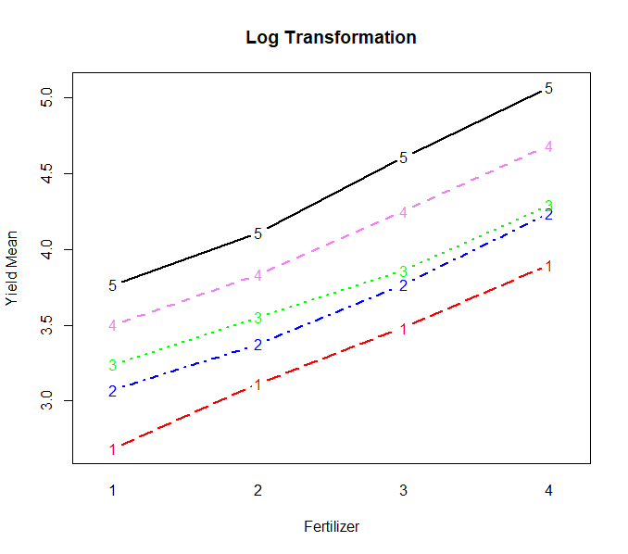
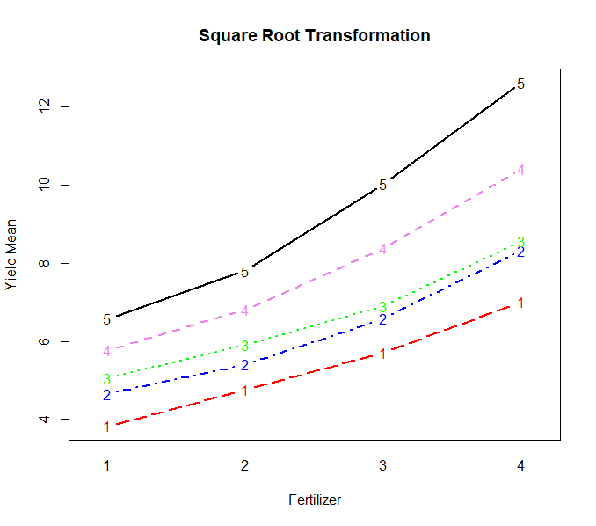

Slide 25
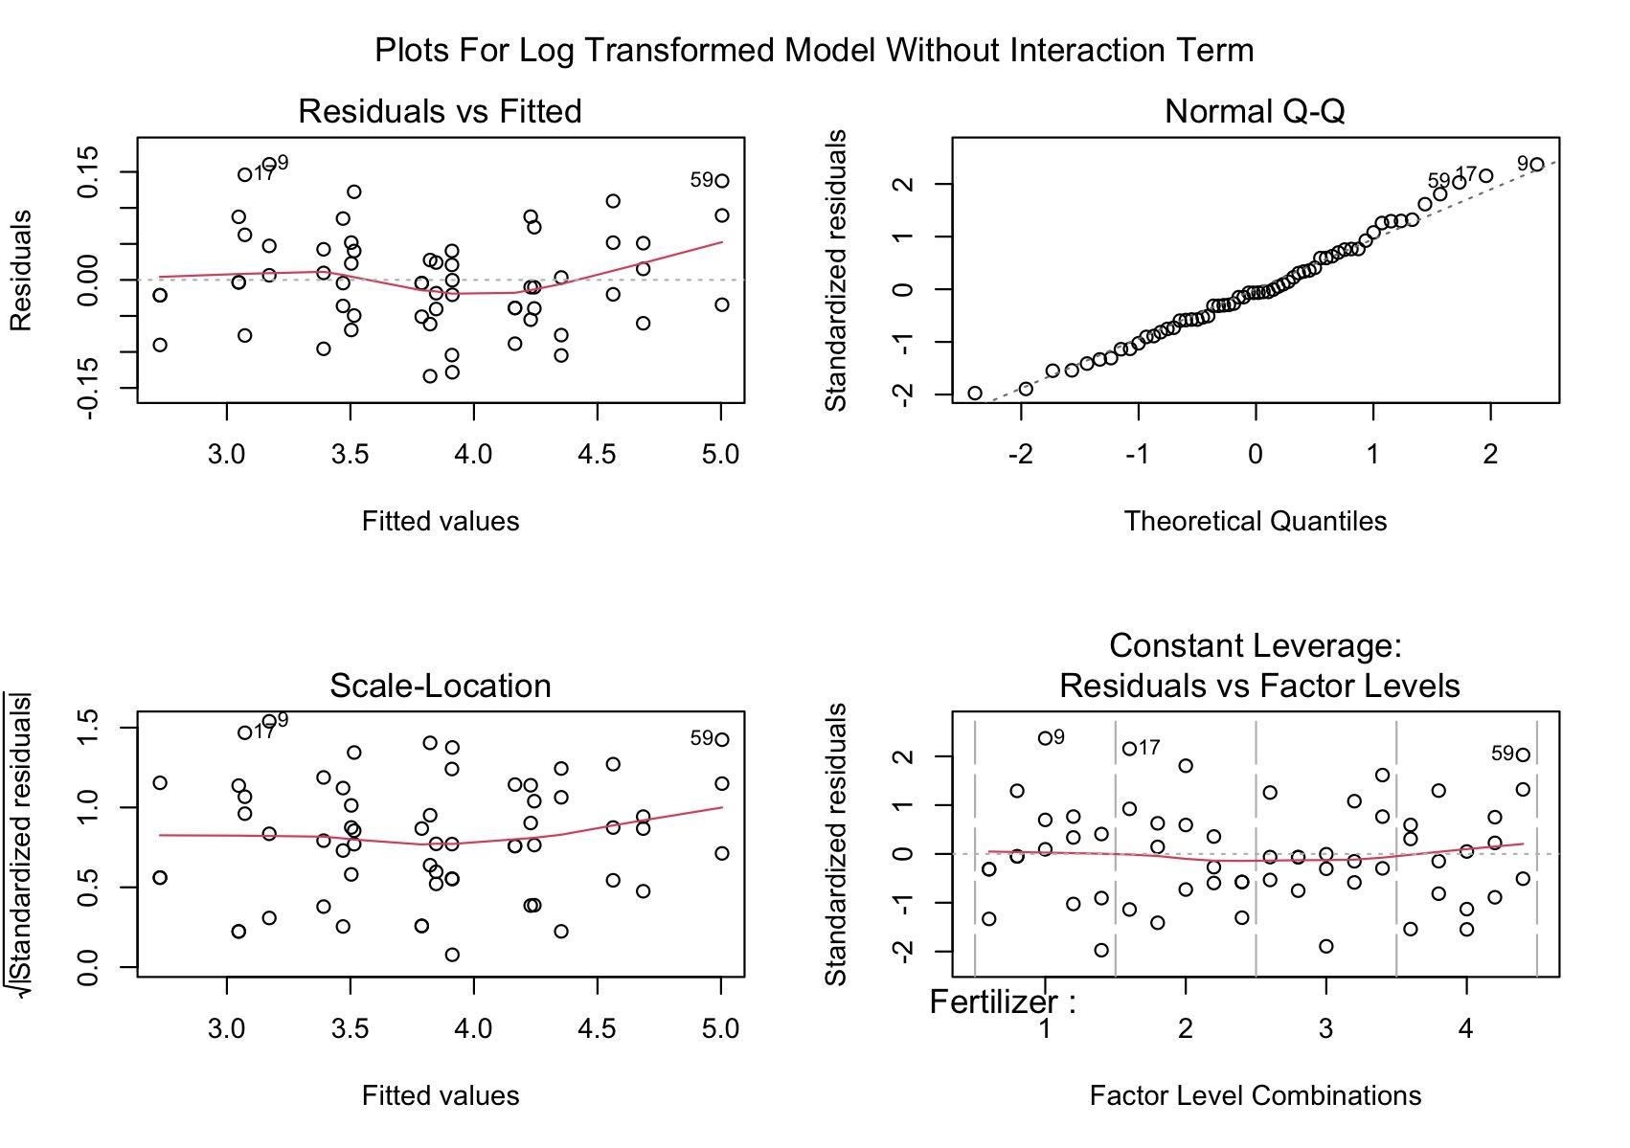

Slide 26

Leverage, Influence, Cook’s distance (1)
For a point to be influential, i.e. to strongly influence the least squares regression line, it needs to:
Have a large residual
Have a high leverage
Cook’s distance measures influence. Useful for checking the validity of influential data points.
>1
>4/n (in our example: 4/60 = 0.066)
Birdview
Principle: removing the data point and checking how the model changes
YouTube Video
Statistics How To
Wiki - Cook's Distance

Slide 27
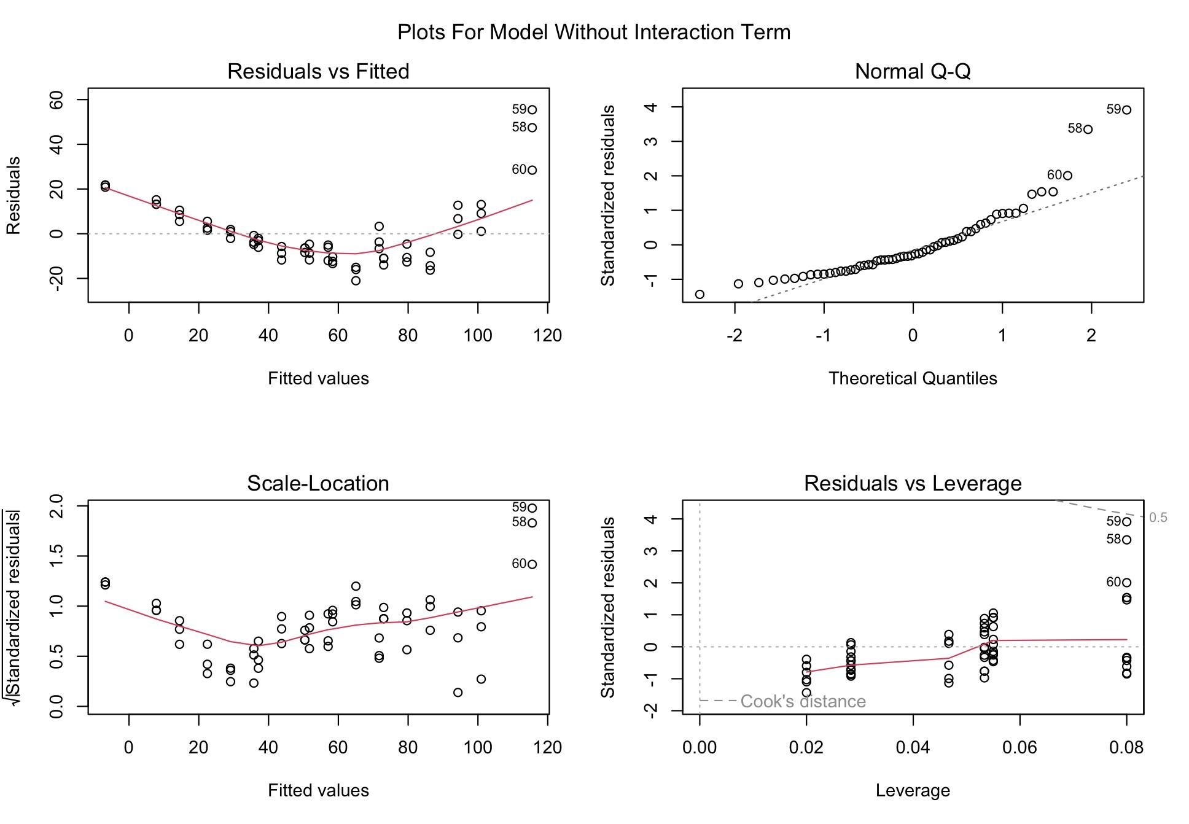
Cook’s distance, worst model (2)

Slide 28
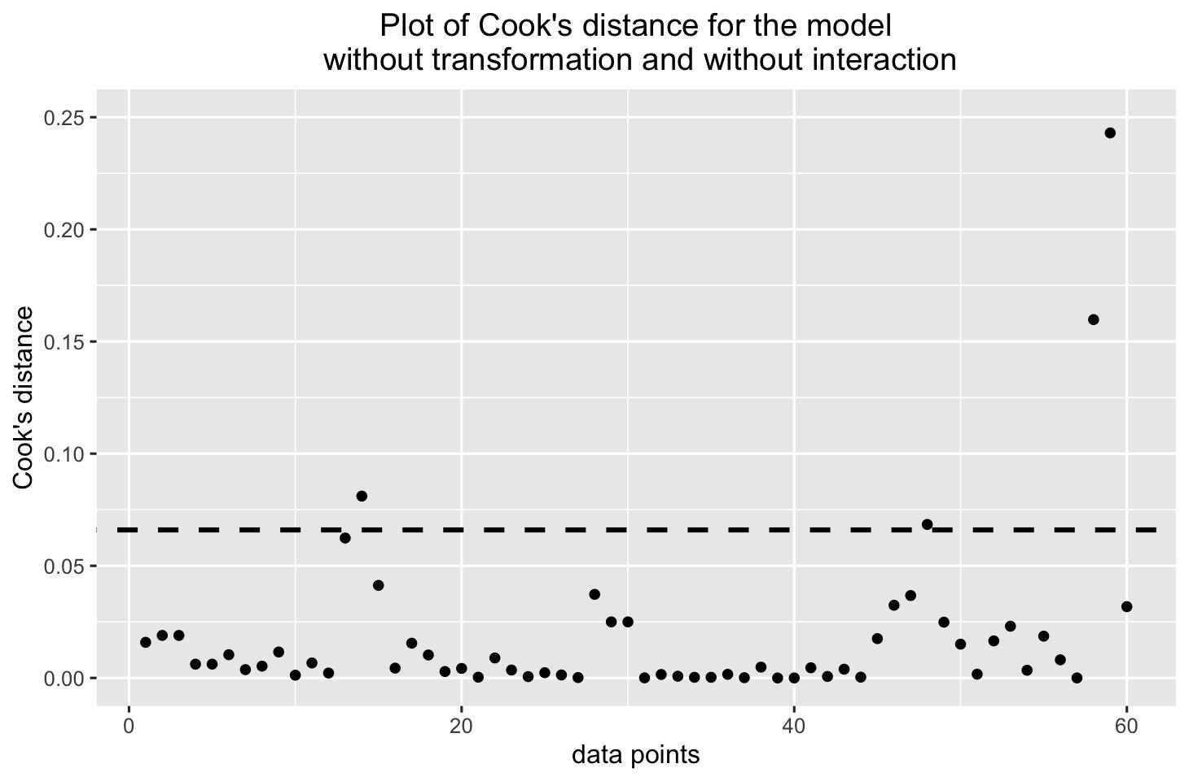
Cook’s Distance, Worst Model (3)

Slide 29
Cook’s Distance, Best Model (4)

Slide 30
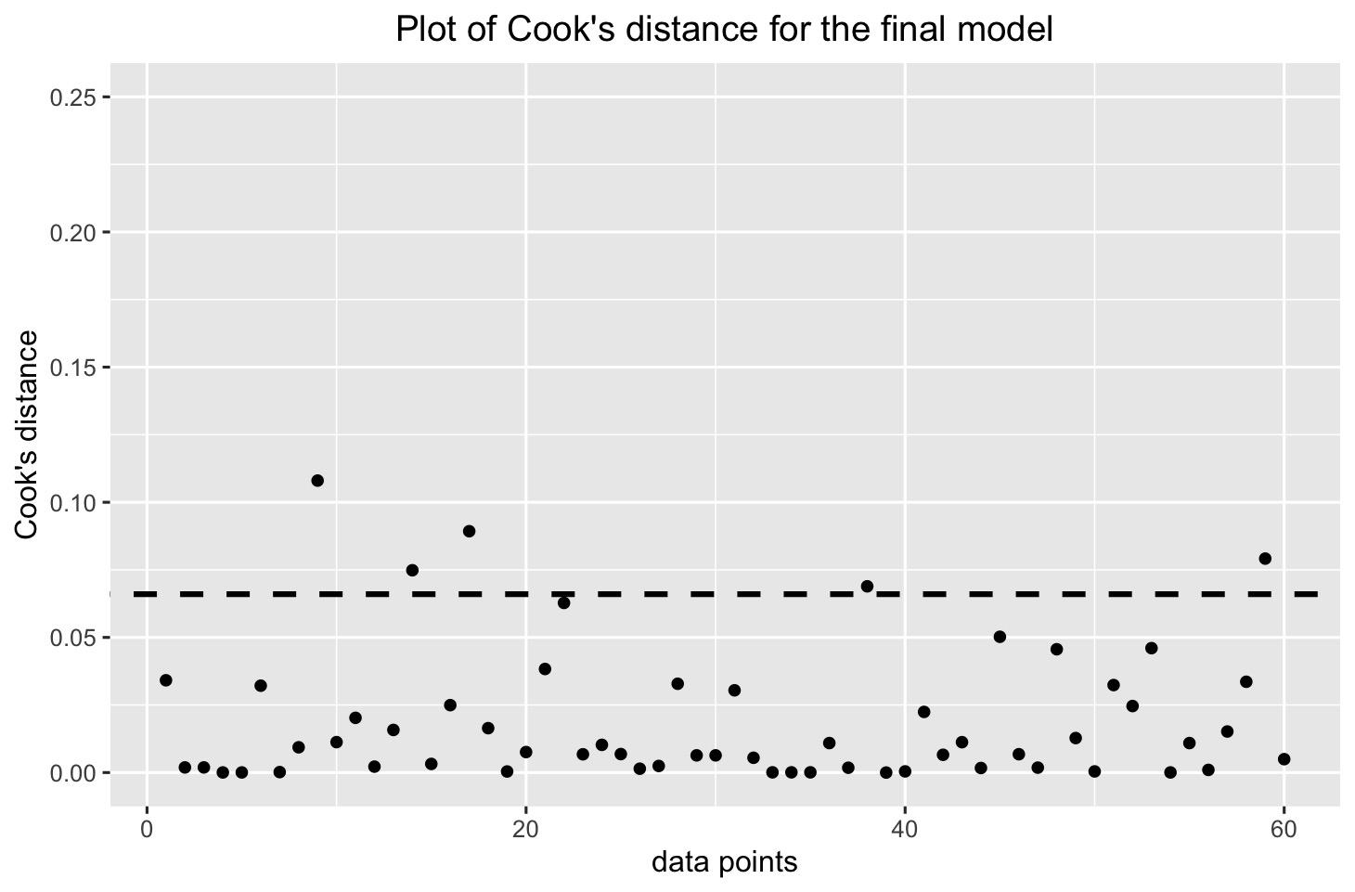
Cook’s Distance, Best Model (5)

Slide 31
Cook’s Distance, Model Comparison (6)

Slide 32
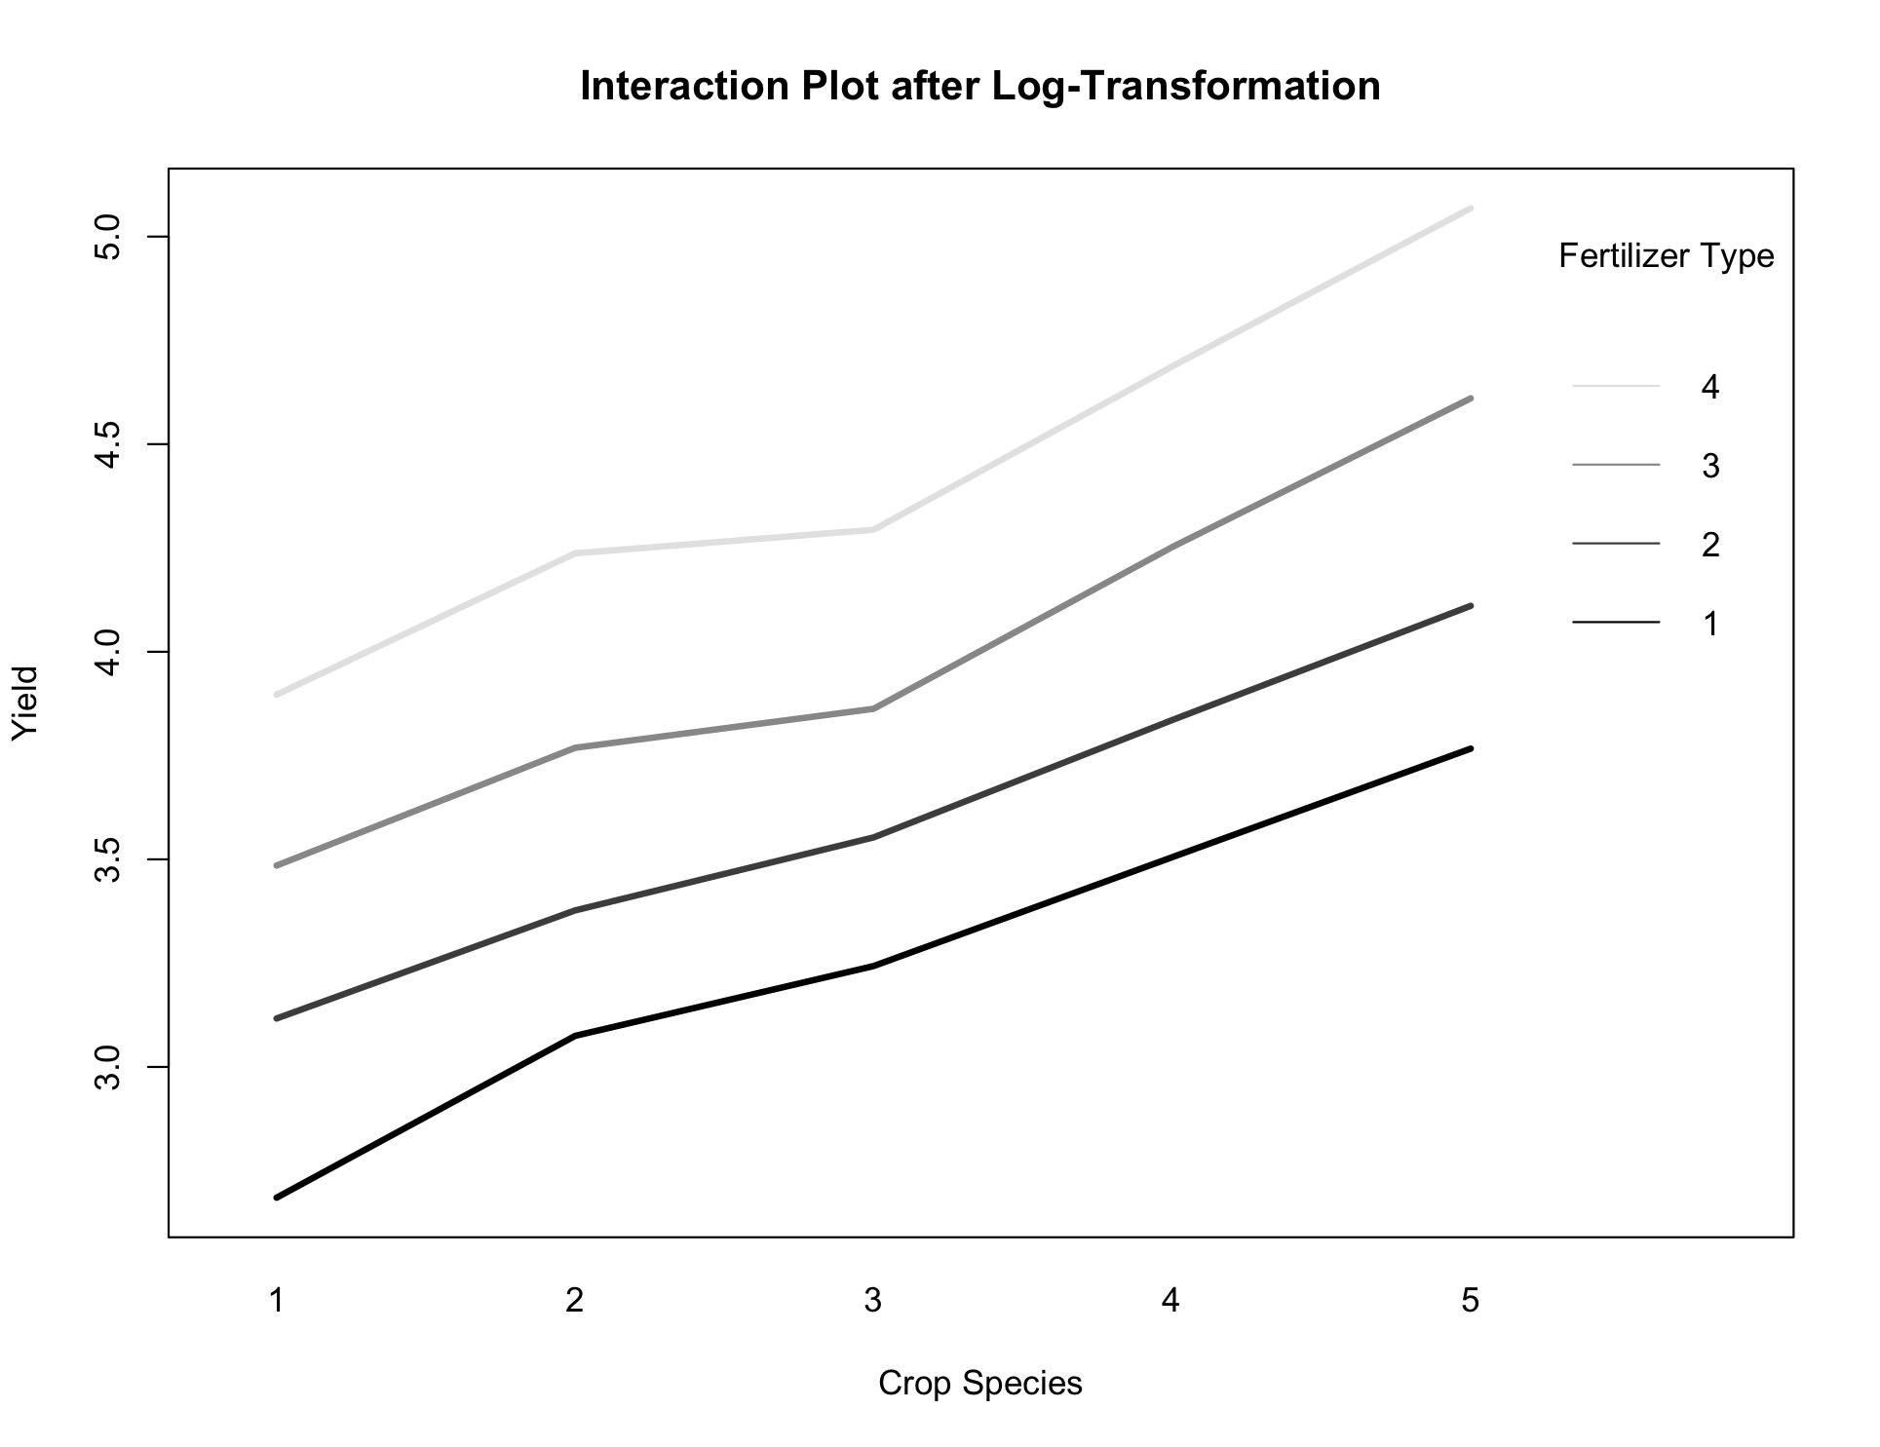
Conclusion on Transformation
Log transformation of the yield (response variable) appropriately addresses the right-skewness seen in the residuals.
After transformation, the assumptions for normality & homoscedasticity are met.
Interaction plot appears more parallel.

Slide 33
05
ANOVA with Interaction
(c) Add an interaction term to the model. Is the interaction significant?

Slide 34
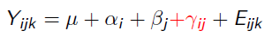

Two-Way ANOVA with Interaction
Mean of baseline group
Second factor
Response variable
Error term
First factor
Interaction term

Slide 35
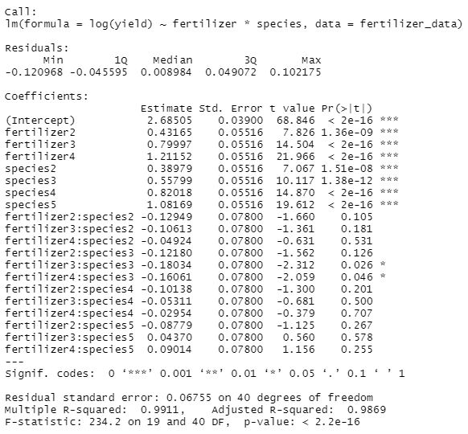
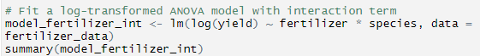
ANOVA Model with Interaction

Slide 36
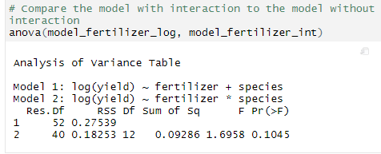
Model Comparison
p value > 0.05: interaction term is not significant.
The interaction term can be removed from the model.
Proceed with the simpler model since the more complex model doesn’t provide a significant benefit
Conclusion: There is no significant interaction between fertilizer type and crop species in the log-transformed data.

Slide 37
06
Model Selection
(d) Beginning from the model in (c), perform model selection by removing non-significant terms.

Slide 38
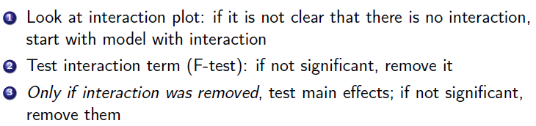
Model Selection for Two-Way ANOVA
Interaction plot showed subtle interaction.
F-test result was p > 0.05, interaction term not significant, remove it
Now we test if the main effects (Fertilizer and CropSpecies) are significant.

Slide 39
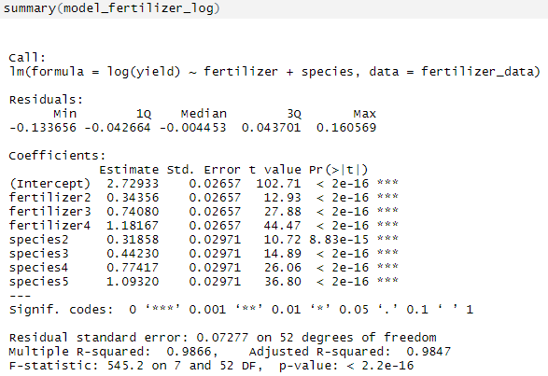
Starting Point: Log Model without Interaction
All levels of both main effects are statistically significant.
I.e. both fertilizer type and crop species have a significant effect on the log-transformed yield.

Slide 40
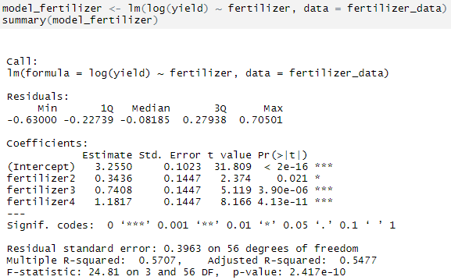
Is Fertilizer Type Significant?
All levels of the Fertilizer factor are statistically significant.
Conclusion: The Fertilizer factor is significant, so we keep it.

Slide 41
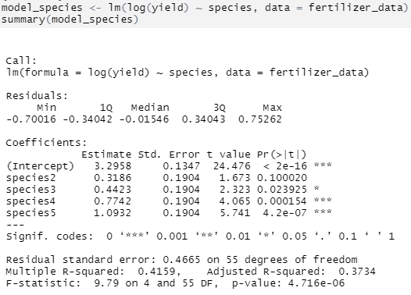
Is Crop Species Significant?
Not all levels of the CropSpecies factor are statistically significant.
Even if one level isn't significant, the factor as a whole still has a significant effect (p < 0.05).
Conclusion: The CropSpecies factor is significant, so we keep it.

Slide 42
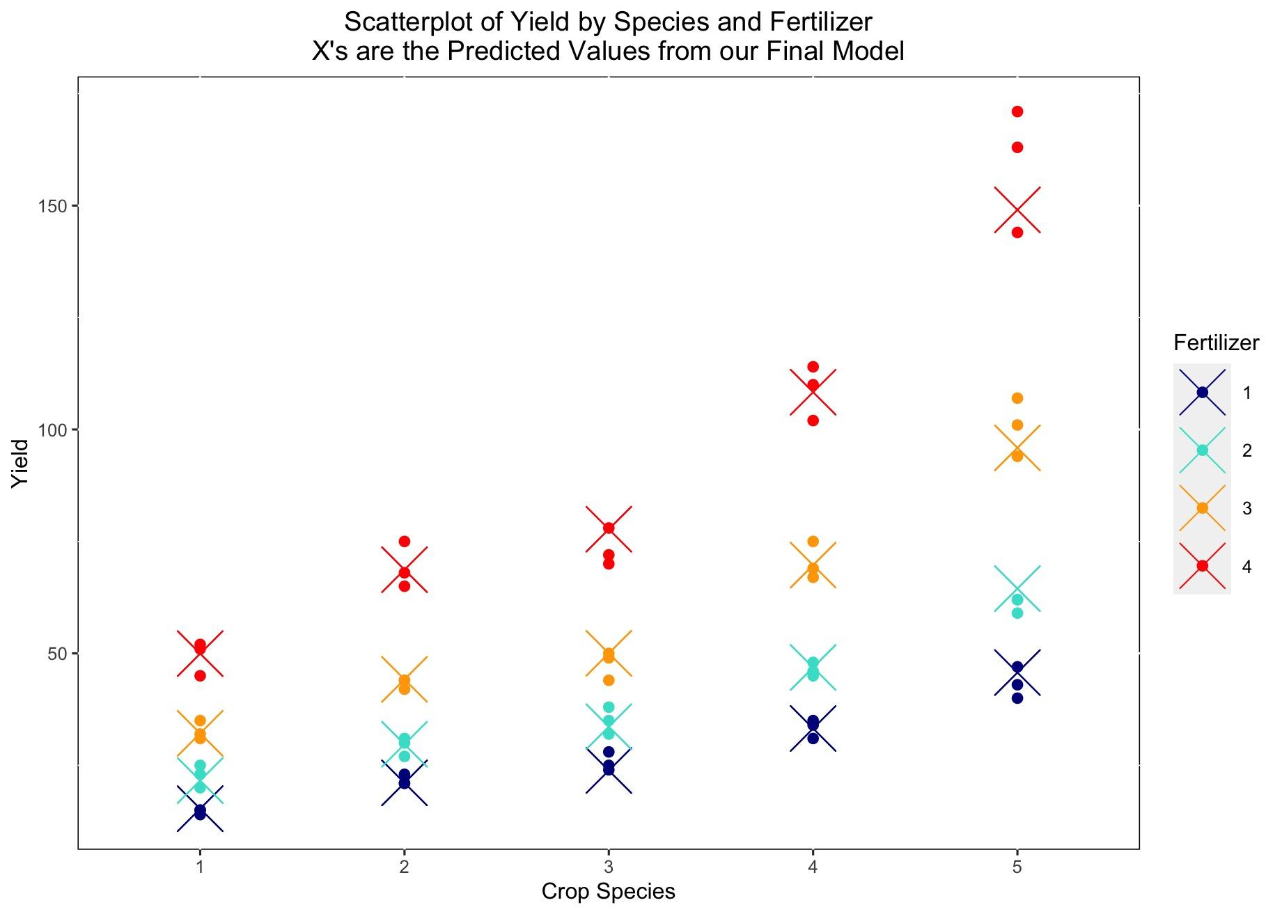
The Final Model
Goodbye
The final model includes both main effects.
It is given by the log transformed model with no interaction:
log(Yield) ~ Fertilizer + CropSpecies.
We hope you have understood the importance we have on planet Earth. Without us, it would be difficult for you to live
Take care of us and we will take care of you!

Slide 43
07
Concluding Remarks

Slide 44
Appropriate transformations: Log transformation rectified residual skewness and variance issues, improving model accuracy.
Factorial effects: Identified significant effects of fertilizer type and crop species on yield.
Interaction effects: Despite initial indications, no significant interaction was observed between fertilizer type and crop species post-transformation.
Subtle Influences: While the interaction model was insignificant, subtle influences of one factor on the other were observed.
Model Selection: Favour simpler models when the additional complexity does not provide a significant benefit.
Practical implications: Optimization of fertilizer use across different crop species.

Slide 45

Thanks
Any questions?
Notes:
https://drive.google.com/drive/folders/1mAvlmrv09wMJkZCWZvc1MuC6n9aAO4d2?usp=drive_link

